Slide 1
DIABETIC RETINOPATHY STAGE CLASSIFICATION USING CNN
Nikhil M.N
TVE16MCA 39
College of Engineering, Trivandrum
March 17 2019
‹#›

Slide 2
Problem statement
People with diabetes can have an eye disease called diabetic retinopathy.
This is when high blood sugar levels cause damage to blood vessels in the retina.
These blood vessels can swell and leak. Or they can close, stopping blood from passing through.
At first, diabetic retinopathy may cause no symptoms or only mild vision problems. Eventually, it can cause blindness.
‹#›

Slide 3
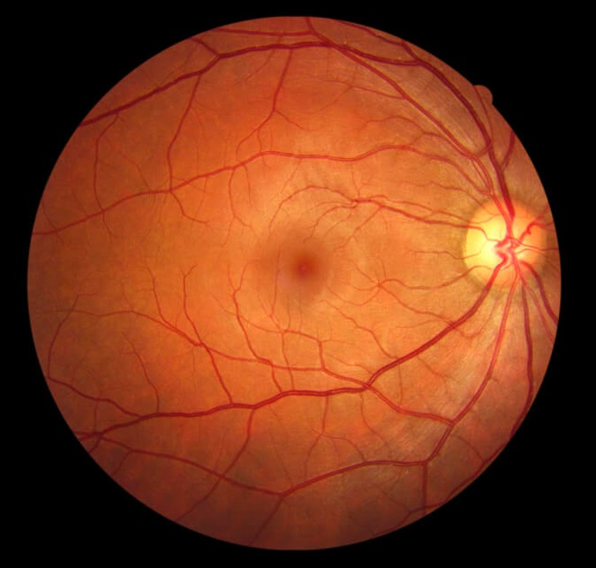
Normal Retina
‹#›

Slide 4
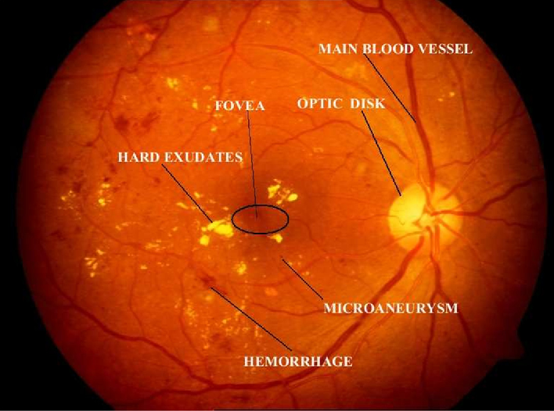
Diabetic Retinopathy
‹#›
Notes:
‹#›

Slide 5
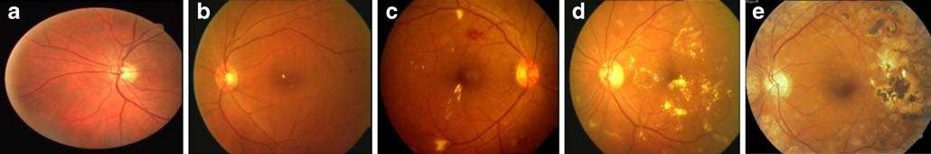
Stages of Diabetic Retinopathy
5 stages of Diabetic Retinopathy are
1. No Diabetic Retinopathy
2. Mild Nonproliferative Retinopathy
3. Moderate Nonproliferative Retinopathy
4. Severe Nonproliferative Retinopathy
5. Proliferative Retinopathy
‹#›

Slide 6
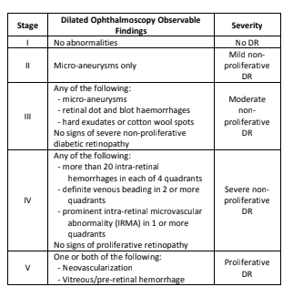

Slide 7


Risk & Cause Vision Loss of DR
All people with diabetes—both type 1 and type 2—are at risk. That's why everyone with diabetes should get a comprehensive dilated eye exam at least once a year.
Blood vessels damaged from diabetic retinopathy can cause vision loss in two ways:
proliferative retinopathy
macular edema.
Normal vision Same scene viewed by a person with DR

Slide 8
Diabetic Retinopathy Symptoms
Blurred vision
Floaters
Fluctuating vision
Distorted vision
Dark areas in the vision
Poor night vision
Impaired color vision
Partial or total loss of vision
‹#›

Slide 9
Existing System
Fluorescein angiography
With your eyes dilated, your doctor takes pictures of the inside of your eyes. Then your doctor will inject a special dye into your arm vein and take more pictures as the dye circulates through your eyes' blood vessels. Your doctor can use the images to pinpoint blood vessels that are closed, broken down or leaking fluid.
Optical coherence tomography
Your eye doctor may request an optical coherence tomography (OCT) exam. This imaging test provides cross-sectional images of the retina that show the thickness of the retina, which will help determine whether fluid has leaked into retinal tissue. Later, OCT exams can be used to monitor how treatment is working.
‹#›

Slide 10
Objectives
Diabetic retinopathy (DR) staging is important for the estimation of diabetes mellitus (DM) and the evaluation of associated retinopathy; it is also closely related with proper management and prognosis of DR.
In order to objectively and accurately determines the diabetic retinopathy stages, an image analysis-based approach to automatically differentiate the 5 stages of diabetic retinopathy based on fundoscopic images is developing
Here CNN is used which is a category of neural networks that are proven to be effective in image recognition and classification . It extends neural networks by adding the operations of convolution ,non-linearity and sub-sampling.

Slide 11
Methods for Proposed Methodology
Here 3 neural network architectures, such as AlexNet, VGG16 and InceptionNet V3 are deploying for the DR stage classification.
AlexNet
An important feature of AlexNet is the introduction of the ReLU nonlinearity into the training of neural network.
Another important features of AlexNet is “dropout”, the action of setting the output of each hidden neurons to zero with a probability of 50%, in the last few fully connected layers to further fix the overfitting problem. The dropped-out neurons do not contribute to the forward propagation process.
VGG16
VGG16 investigates the effect of the convolutional network depth on classification accuracy in the large-scale image recognition setting.
The advantage of VGG16 is its simple and standardized approach of constructing the hidden layers.

Slide 12
InceptionNet
Inception architecture of GoogLeNet is designed to perform well even under strict constraints on memory and computational budget.
To achieve this, GoogLeNet utilized channel concatenation: concatenating the channels obtained from 1 × 1 convolution, 3 × 3 convolution, 5 × 5 convolution and pooling together while keeping the height and width of each channel unchanged.
To avoid the exponentially increase of the mathematical operations that have to be done for channel concatenation, 1 × 1 “bottleneck” layers that have shallower channel depths are applied before applying 3 × 3 or 5 × 5 convolution.

Slide 13
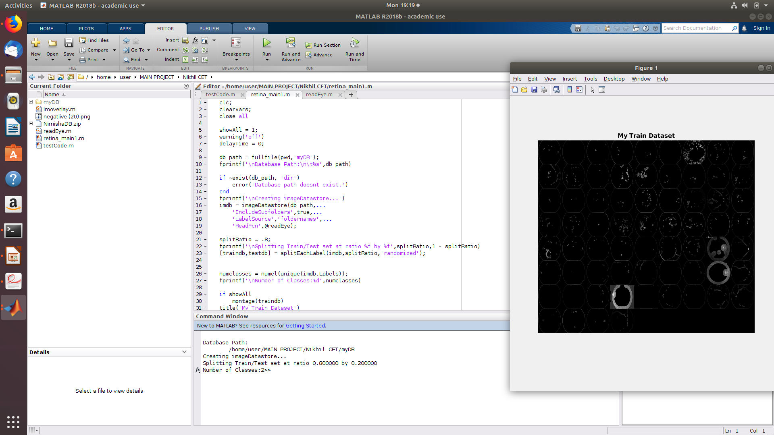
SCREENSHOT

Slide 14
CONCLUSION
Diabetic Retinopathy (DR) stage classification has been regarded as a critical step for evaluation and management of diabetes retinopathy.
Because of damages of the retina blood vessels caused by the high blood glucose level, different extent of microstructures, such as micro-anuerysms, hard exudates, and neovascularization, could occupy the retina area.
In this project, representative Diabetic Retinopathy (DR) images have been aggregated into five categories according to the expertise of ophthalmologist. A group of deep Convolutional Neural Network methods have been employed for DR stage classification. State-of-the-art accuracy result will be achieved by InceptionNet V3, which demonstrates the effectiveness of utilizing deep Convolutional Neural Networks for DR image recognition.

Slide 15
REFERENCE
Xiaoliang Wang ,Yongjin Lu ,Yujuan Wang ,Wei-Bang Chen,” Diabetic Retinopathy Stage Classification Using Convolutional Neural Networks ”,2018 IEEE International Conference on Information Reuse and Integration (IRI)
M.M. Habib1, R.A. Welikala1, A. Hoppe1, C.G. Owen2, A.R. Rudnicka2 and S.A. Barman1,”Microaneurysm Detection in Retinal Images Using an Ensemble Classifier ”,School of Computing, Faculty of Science, Engineering and Computing, Kingston University, London, United Kingdom
M. Alban and T. Gilligan, “Automated detection of diabetic retinopathy using fluorescein angiography photographs,” Stanford Technical Report, 2016.

Slide 16
THANK YOU
‹#›

